Slide 1
CONTENTS
INTRODUCTION
ABSTRACT
LITERATURE SURVEY
ARCHITECTURE OF SELF DRIVING CAR CONTROL SYSTEM:
BLOCK DIAGRAM
PROPOSED SYSTEM(AUTOMATION)
PICTORIAL VIEW OF THE PROPOSED MODEL
PICTURE OF SELFCONTROL ROBOTIC CAR
HARDWARE AND SOFTWARE REQUIREMENTS
EXPECTED RESULT
ADVANTAGES & DISADVANTAGES
REFERENCES

Slide 2
ABSTRACT:
The evolution of the artificial intelligence has served as the catalyst in the field of technology.
We can now develop things which was once just an imagination.
One of the such creation is the birth of self driving car.
Days have come one can do their work even touching steering wheel ,accelerator you will still be able to reach your target destination safely.

Slide 3
INTRODUCTION
Self driving car (Robot car) is a robotic vehicle that is designed to travel between destination without human intervention.
It is capable of sensing environment and navigate without human input.
Autonomous cars must have control systems that are capable of analysing sensor data to distinguish between different cars on the road.
The potential benefits of autonomous cars include reduced mobility and infrastucture costs,increased safety,increased mobility,increased customer sartisfaction and reduced crime.

Slide 4
LITERATURE SURVEY
Title 1: Working model of Self-driving car using Convolutional Neural Network, Laptop with Arduino and Arduino
Author: Aditya Kumar Jain
Year: 01 October 2018
The evolution of Artificial Intelligence has served as the catalyst in the field of technology. We can now develop things which was once just an imagination. One of such creation is the birth of self-driving car. Days have come where one can do their work or even sleep in the car and without even touching the steering wheel, accelerator you will still be able to reach your target destination safely.
Title 2: As Fault: Testing Self-Driving Car Software Using Search-Based Procedural Content Generation
Authors: Alessio Gambi; Marc Mueller; Gordon Fraser
Year: 19 August 2019
Ensuring the safety of self-driving cars is important, but neither industry nor authorities have settled on a standard way to test them. Deploying self-driving cars for testing in regular traffic is a common, but costly and risky method, which has already caused fatalities.

Slide 5
LITERATURE SURVEY:
Title 3: Propulsion Motor Drive Topology Selection for Further Development of ISEAUTO Self-Driving Car
Authors: A. Rassõlkin ; T. Vaimann ; A. Kallaste ; R. Sell
Year: 07 March 2019
Studies on self-driving cars are growing popularity nowadays. It is a multidisciplinary topic, which includes artificial intelligence, communication systems, control algorithms, electrical and mechanical applications, etc. A lot of effort is put on the objects recognition and artificial intelligence learning topics, however, the propulsion motor drive of such vehicles also requires special attention.

Slide 6
Levels of driving automation:
In SAE's automation level definitions, "driving mode" means "a type of driving scenario with characteristic dynamic driving task requirements (e.g., expressway merging, high speed cruising, low speed traffic jam, closed-campus operations, etc.)"
Level 0: Automated system issues warnings and may momentarily intervene but has no sustained vehicle control.
Level 1 ("hands on"): The driver and the automated system share control of the vehicle. Examples are Adaptive Cruise Control (ACC), where the driver controls steering and the automated system controls speed; and Parking Assistance, where steering is automated while speed is under manual control. The driver must be ready to retake full control at any time. Lane Keeping Assistance (LKA) Type II is a further example of level 1 self-driving.
Level 2 ("hands off"): The automated system takes full control of the vehicle (accelerating, braking, and steering). The driver must monitor the driving and be prepared to intervene immediately at any time if the automated system fails to respond properly. The shorthand "hands off" is not meant to be taken literally. In fact, contact between hand and wheel is often mandatory during SAE 2 driving, to confirm that the driver is ready to intervene.

Slide 7
Level 3 ("eyes off"): The driver can safely turn their attention away from the driving tasks,
e.g. the driver can text or watch a movie. The vehicle will handle situations that call for an immediate response, like emergency braking. The driver must still be prepared to intervene within some limited time, specified by the manufacturer, when called upon by the vehicle to do so. As an example, the 2018 Audi A8 Luxury Sedan was the first commercial car to claim to be capable of level 3 self-driving. This particular car has a so-called Traffic Jam Pilot. When activated by the human driver, the car takes full control of all aspects of driving in slow-moving traffic at up to 60 kilometres per hour (37 mph). The function works only on highways with a physical barrier separating one stream of traffic from oncoming traffic.
Level 4 ("mind off"): As level 3, but no driver attention is ever required for safety, e.g. the driver may safely go to sleep or leave the driver's seat. Self-driving is supported only in limited spatial areas (geofenced) or under special circumstances, like traffic jams. Outside of these areas or circumstances, the vehicle must be able to safely abort the trip, e.g. park the car, if the driver does not retake control.
Level 5 ("steering wheel optional"): No human intervention is required at all. An example would be a robotic taxi.

Slide 8
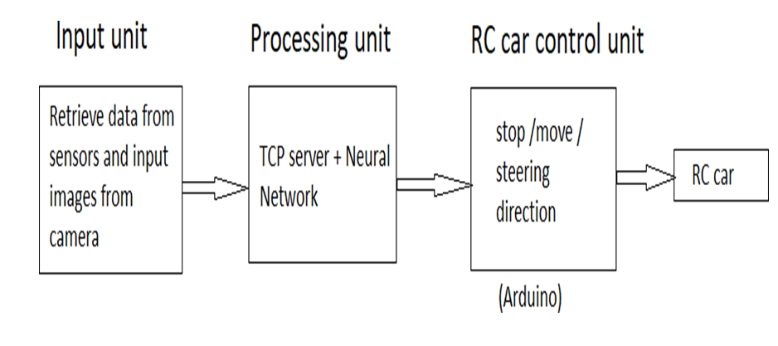
BLOCK DIAGRAM

Slide 9
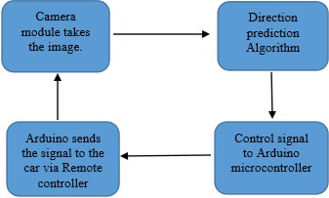
PROPOSED SYSTEM

Slide 10
PROPOSED SYSTEM
This development aims to build a monocular vision autonomous car prototype using Laptop with Arduino as a processing chip.
An HD camera along with an ultrasonic sensor is used to provide necessary data from the real world to the car.
The car is capable of reaching the given destination safely and intelligently thus avoiding the risk of human errors.
Many existing algorithms like lane detection, obstacle detection are combined together to provide the necessary control to the car.
A neural network model runs on computer and makes predictions for steering based on input images.

Slide 11
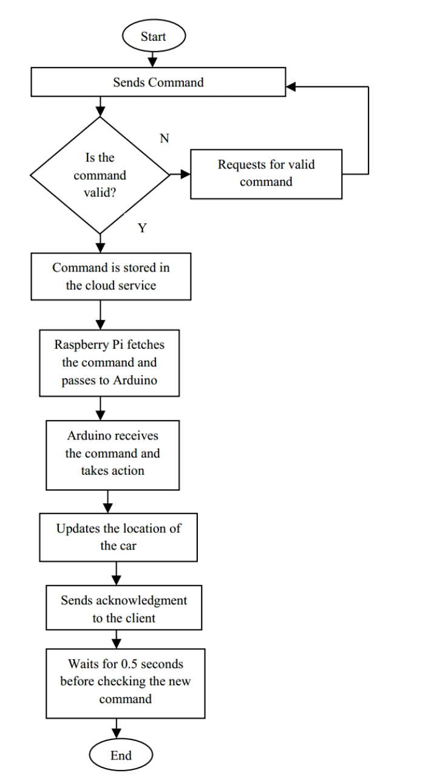
PROPOSED SYSTEM(VOICE CONTROLLED)
Sending command.
Checks for command validation.
Stores command in cloud service.
Raspberry Pi commands in cloud service.
Laptop with Arduino collects the command and passes to the Arduino.
Arduino takes action according to the command.
Updates GPS position of the car.
Sends acknowledgement to the user.

Slide 12
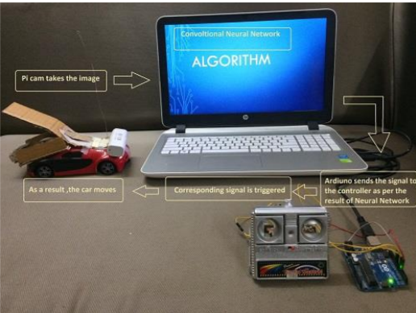
PICTORIAL VIEW OF THE PROPOSED MODEL

Slide 13
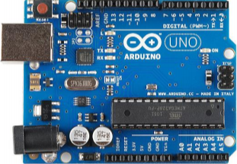
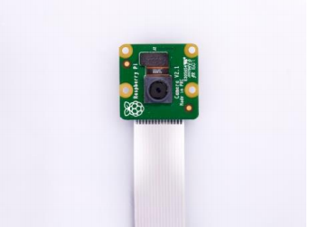
HARDWARE REQUIREMENTS:
Arduino Uno.
Aurdino Micro controller.
Wireless camera.
Ultrasonic distance sensor
IR Sensor

Slide 14
SOFTWARE REQUIREMENTS:
Open CV.
Python.
Linux.

Slide 15
EXPECTED RESULTS
The autonomous car is able to travel between destination safely without human intervention.
Reduced mobility and infrastructure cost.
Reduced parking problems.
Avoid accidents.
Increased customer satisfaction.

Slide 16
ADVANTAGES:
Better road safety.
Reduced commute time.
Increased productivity.
Reduced expenditure.
Environment friendly.

Slide 17
DRAWBACKS:
Loss of driving related jobs.
Loss of jobs in public transit services crash repair jobs.
Privacy issues.

Slide 18
REFERENCES
[1] B. K. P. Horn, “Suppressing traffic flow instabilities,” Intelligent Transportation Systems-(ITSC), 2013 International IEEE Conference on.
[2] T. Baran and B. K. P. Horn, “A Robust Signal-Flow Architecture For Cooperative Vehicle Density Control,” ICASSP (2013).
[3] L. Wang, B. K. P. Horn and G. Strang, “Eigenvalue and Eigenvector Analysis of Stability for a Line of Traffic,” Studies in Applied Mathematics, vol.138, January 2017.
[4] B. K. P. Horn, Robot Vision. MIT Press, Massachusetts, 1986.
[5] B. K. P. Horn, Y. Fang, and I. Masaki, “Time to contact relative to a planar surface,” IEEE intelligent vehicles symposium. 2007.
[6] B. K.P. Horn and Brian G. Schunck, “Determining optical flow,” Artificial intelligence 17.1-3 (1981): 185-203.
[7] A. R. Bruss and B. K. P. Horn, “Passive navigation,” Computer Vision Graphics, and Image Processing 21.1 (1983): 3-20.

Slide 19
Thank You…

